Slide 1
Why spatial econometrics?
Dr hab. Katarzyna Kopczewska, prof. ucz.
Faculty of Economic Sciences University of Warsaw

Slide 2
Why do we need spatial econometrics?
What do we observe?
Units with regard to their location may not be independent
Firms
Regions, cities
Environment areas
In static approach: there may exist relationships between them
Relation of similarity (like business within a cluster, local units within region, polluted area around)
Relation resulting from core-periphery patterns – distance decay pattern
Externalities – some features in one place impact other features around
In dynamic approach: there may exist flows between them
Migrations, trade – following distance decay pattern, directed by some actions
Diffusion - mechanisms of expansion and relocation

Slide 3
Why do we need spatial econometrics?
So why do we need spatial econometrics?
Why not? – Availability of spatial datasets, well-developed software
Accuracy – To improve modelling techniques. We observe estimation bias / inconsistency in non-spatial methods (existence of spatial association violates an important statistical assumption: independence) as the BLUE / OLS requirements of independence of units is not fulfilled
Value added – new hypothesis to be tested, one can use this information on spatial dependence
To follow natural patterns – social phenomena are often clustered in space

Slide 4
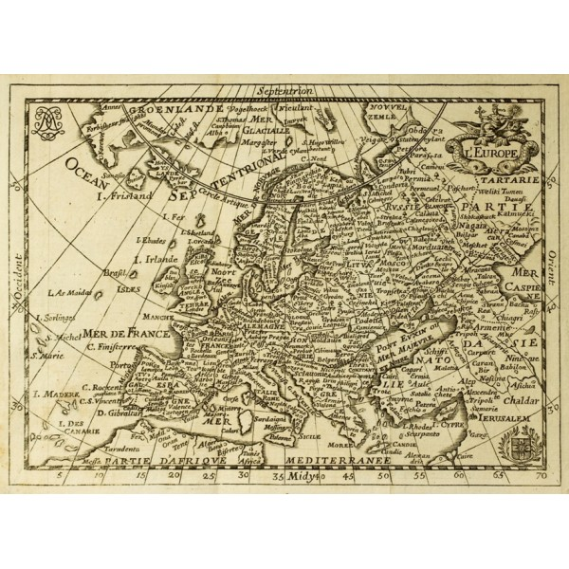
Why we should use spatial data and methods?
Let’s start with classics - the first law of geography
Waldo Tobler (1970) „Everything is related to everything else, but near things are more related than distant things.”¹
This is spatial friction. It creates the foundations of spatial dependence and spatial autocorrelation.
Location and distance matter!
Existance and structure of spatial dependence matter!
Issues: distance -> distance decay and location -> closeness (similarity)
¹ Interesting discussion on „laws”: Tobler W., 2004, On the First Law of Geography: A Reply, Annals of the Association of American Geographers, 94(2), 2004, pp. 304–310

Slide 5
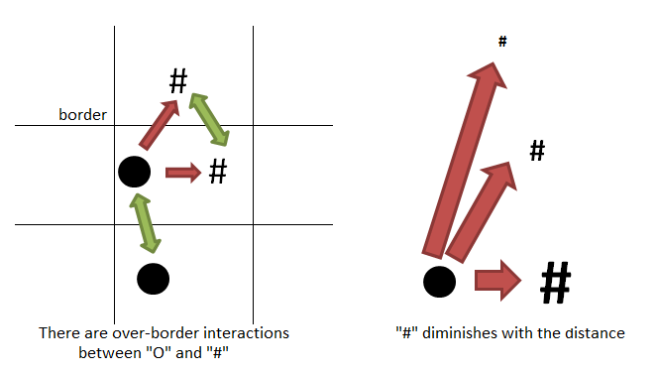
Static spatial relations
Way of modelling | With the use of spatial weights matrix | With the use of distance

Slide 6
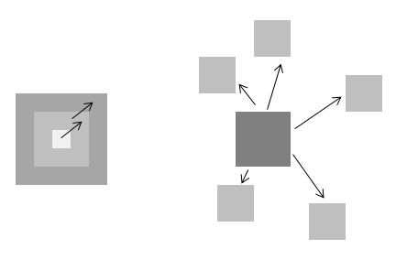
Dynamic spatial relations
 | Contigous (with spatial continuity) | Hierarchical (possible „jump” – spatial discountinuity)
Expansion | Flow of ideas and innovations on the local level | Flow of ideas and innovations from central locations down the hierarchy
Relocation | City sprawl | Inernational migrations
Way of modelling | With the use of spatial weights matrix | With the use of distance

Slide 7
Main spatial effects
Spatial autocorrelation - the correlation of a variables with itself
In time series: variable in time t depends on the same variable in time t-1
in spatial analysis: variable in location s depends on the same variable in location s-1 (neighbourhood)
Positive autocorrelation – high-value (or low-value) observations cluster in space
Negative autocorrelation – neighbouring locations are as different as possible
Spatial heterogenity - lack of stability over the geographical space, differentiation of the effects of space over the sample units (like spatial clusters)
Spatial dependence - what happens in i depends on what happens in j (phenomenon in location j is related to the phenomenon in location i)
Spillover – when phenomenon in i impacts some other phenomenon in j location
Spatial interactions – distance-decaying phenomenon

Slide 8
What to measure ?
Spatial socio-economic phenomena
Invisible
Visible
Policy flow
Core-periphery pattern and its persistance
Diffusion – usually from core to periphery
Cohesion and convergence mechanisms
Institutional rent
Effects of administrative division
Role of infrastructure
Migrations
Trade
Labour market
Education patterns
Business development
GDP and growth
Usually we want see an observalble effect and conclude about unobservable policy
Usually we want to see an impact of those mechanisms on socio-economic data

Slide 9
Spatial concepts
Spatial statistics
Spatial econometrics
Spatial machine-learning
spatial autocorrelation
spatial dependence
spatial heterogeneity
urban sprawl pattern
spatial spillover
centrifugal diffusion
agglomeration effects
spatial policy transfer
spatial accessibility
spatial concentration
spatial separation
spatial interactions
spatial range
Spatio-temporal effects
(stability of clusters, stationary trend, …)

Slide 10
Instruments in spatial econometrics (1)
Spatial weights matrix W
Different criteria of neighbourhood and the strength of the links
Allows for computing „spatial lag” – average of values in neighbourhood
Can be selected a priori – then it is about the assumption on the nature of links
Can be derived from the data and tested - it plays the role of the filter
Is used in calculations of spatial statistics and estimation of models
Indicates the relative location of units (with regard to each other)
Is crucial in measuring the externalities
(Euclidean) distance
Indicates the spatial separation between units
In core-periphery patterns it shows the relative location as a distance to the core

Slide 11
Instruments in spatial econometrics (2)
Dummies for specific location
For big cities,
when unit belongs to specific region
When unit belongs to cluster
Geodesic coordinates (latitude and longitude)
Treated as absolute location
Applied in expansion models
Spatial filters
Eigenvectors to filter spatial relations
GWR is a special case of spatial filtering – to address spatial heterogenity (instable relation, where regression coefficients change with location)

Slide 12
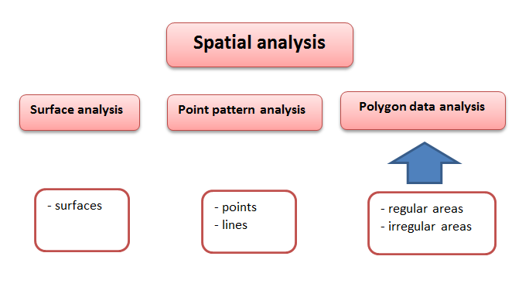
Spatial tools classification
Types of spatial analysis
- Spatial data analysis
- Spatial autocorrelation
- Spatial interpolation
- Spatial regression
- Spatial interaction
- Simulation and modeling
- Multiple-Point Geostatistics (MPS)
Here socio-economic applications only!

Slide 13
How to measure spatial relations?
Why do we need the first glance statistics and charts:
to visualise phenomena
to see patterns, trends and tendencies over time
to get guidelines how to construct model
to see spatial distrubutions and spatial trends
to test for spatial autocorrelation (or spatial regimes)
to identify spatial outliers
to see patterns of spatial associations (spatial clusters)
What we can get from the econometric models:
see significance of variables
filter out spatial autocorrelation
model forecasts
structualise relationships (discover spatial dependence)
analyse spatial heterogenity (clubs)

Slide 14
Why it is worth to controll the diffusion?
Failure to control diffusion means autarkic treatment of individuals
There is a problem of lack of independence of phenomena (spatial autocorrelation), omissions and uncontrolled spatial variation (spatial heterogeneity)
Some of the effects of endo- and exogenous processes and policy implications are transferred to other units (positive / negative external effects, exhausted absorption capacity)
Controlling diffusion does not mean that it always exists – there may be strong internalization of all effects and the suppression of diffusion
Possible effects of backwash

Slide 15
Implications
Spatial dimension is important in monitoring cohesion, convergece and growth
Territories are not independent of each other
Lack of information on the environment should be treated as an omitted information (variable)
Even relatively simple spatial models clearly show the existence of spillover
Understanding the magnitude and directions of spillover allows for better design of policy and intervention
Wider issues and problems
MAUP (Modifiable Areal Unit Problem) – when arbitrally set borders impact the result
Scale effects – when the change in number of units (other level of aggregation) may change the result
Aggregation effects – when different allocation of borders among given number of units may change the result

